Slide 1
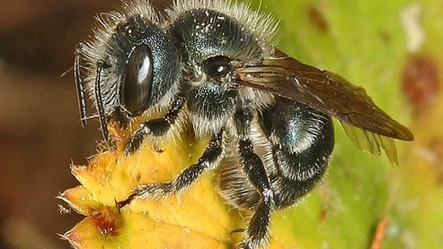
Beneficial Insects in NH

Slide 2
What is happening with insect populations in NH and globally ?
2021-”Insect Decline in the Anthropocene” 45% global decline.
Insect populations in NH significant declines, with 40% native bumblebee and 70% of butterfly species in significant decline.
2019 UNH study dramatic decline in14 wild bee species that serve as pollinators for local crops.“We found that wild bee species that once greatly populated more southern areas ..are now in decline,” Sandra Rehan, professor biological sciences.

Slide 3
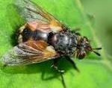
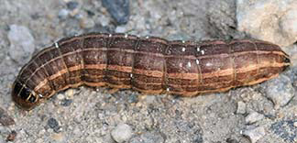
Parasitic Insects
Tachinid Flies- kill garden pests.
Attack squash and stink bugs-lay eggs on their larvae.
Cutworm and Japanese beetle larvae too.

Slide 4
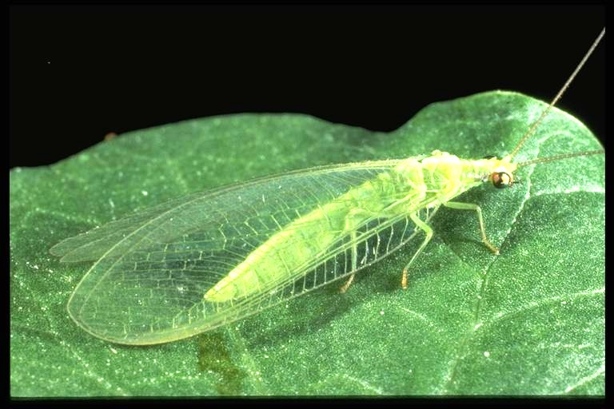
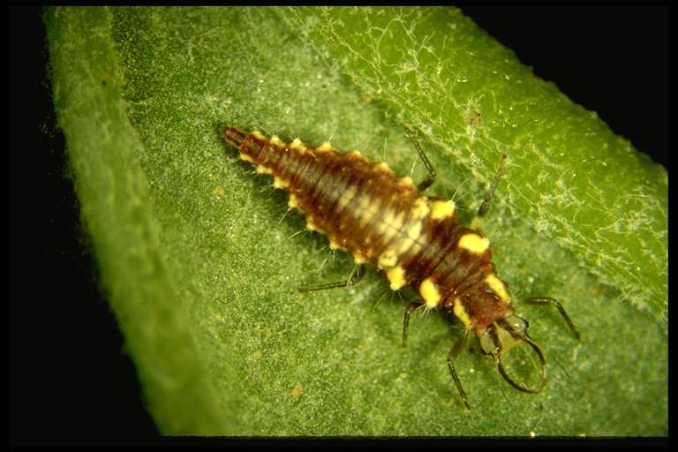
Predator Insects
Lacewings:
Lay eggs near aphids and their larvae feed upon them.
Each whitish, oval egg is laid at tip of long, slender stalk.
Adults locate aphid colonies by smell and lay eggs in clusters nearby.

Slide 5
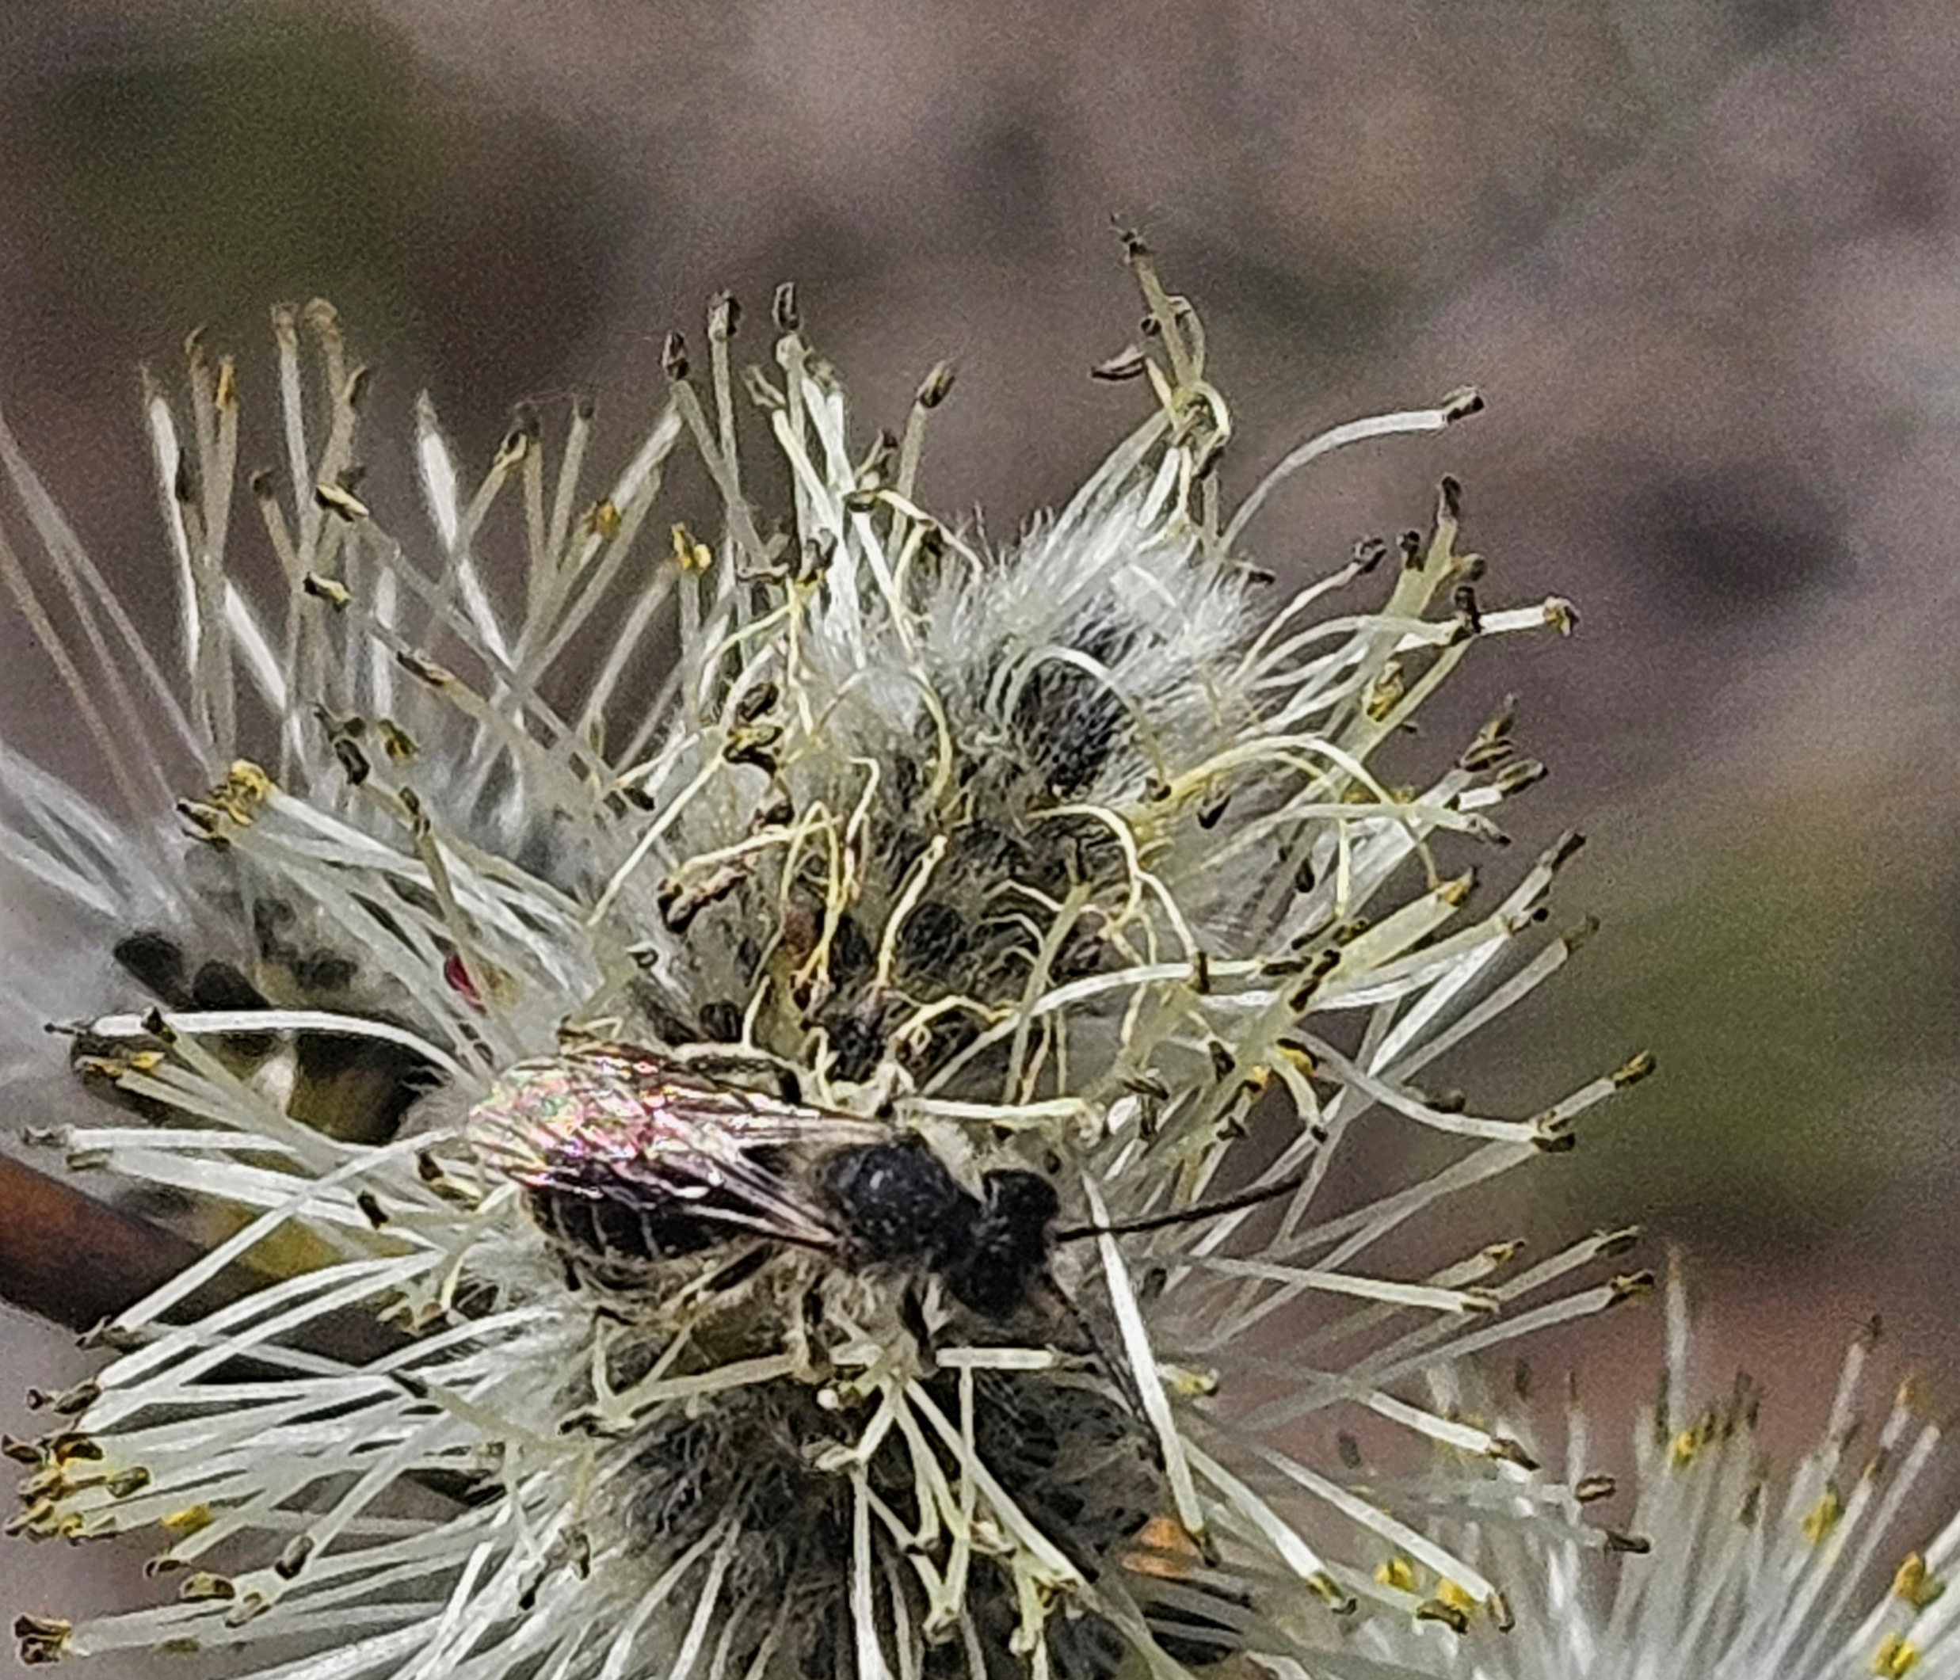
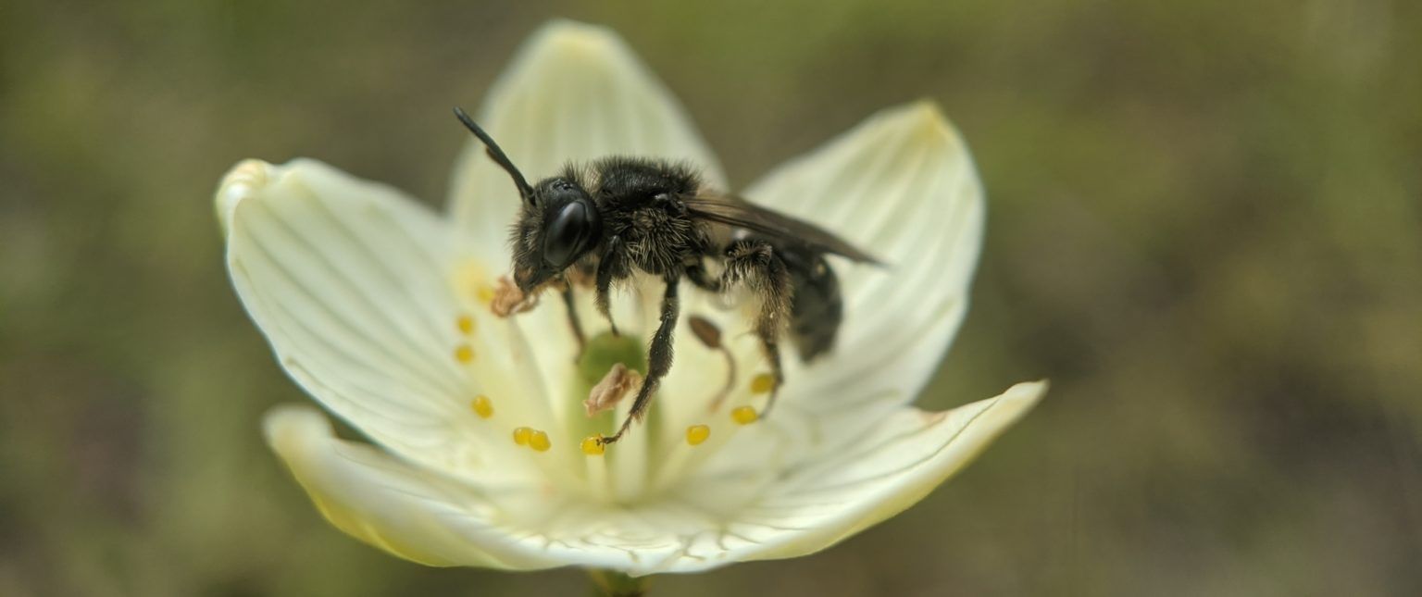
Pollinators
Mining Bees
Early Spring pollinator
Pollinate Pussy Willow, Red Maples and Blueberries - time when limited pollinators around.
Leave bare soil around yard for females to build nests.

Slide 6
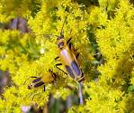
Pollinators-Beetle
Goldenrod Soldier Beetle
Pollinates goldenrod, asters and other late summer-fall flowers in New England
Eats aphids.

Slide 7
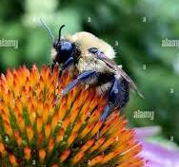
Pollinator King
Common Eastern Bumblebee
Most common Bumblebee in NH.
Pollinates many fruit and vegetables - Zucchini, Tomatoes, Peppers, Raspberries, Blueberries, Cherries.
Pollinates many native wildflowers- asters, goldenrods, coneflowers, milkweeds, and bee balms.
Buzz pollinate –releases pollen from anthers especially for tomatoes and peppers

